Slide 1


Department of Artificial Intelligence and Data Science
Group Members:
Tushar Chavhan
Sakshi Ingale
Vrushali Dhage
Snehal Godage
Roll No.23
Roll No.28
Roll No. 30
Roll No. 49
Under The Guidance of : Prof. Sonam Singh
A.Y.2025-26

Slide 2
Problem Statement & Objectives
Rapid urbanization → increased urban flooding & waterlogging
Existing drainage systems are reactive, not predictive
High latency in SCADA/cloud models → delayed responses
Vulnerable to communication/network failures
Develop an AI-powered, low-latency Edge system for drainage control
Predict water levels in real time using Deep Learning (LSTM)
Enable autonomous gate & pump actuation via Model Predictive Control (MPC)
Provide reliable early warnings and decision support, even without internet
Minimize flood risk & emergency repair costs
Dr. D. Y. Patil Institute of Technology | Artificial Intelligence and Data Science
2

Slide 3
Scope of the Project
Real-time monitoring of rainfall, water levels, and flow
Prediction of overflow risks using LSTM models
Autonomous control of smart gates & pumps through MPC
Edge-based deployment for low-latency decision-making (<300ms)
Dashboard & alert system for authorities and citizens
3

Slide 4
Existing System & Limitations
Existing System | Limitations
SCADA-based monitoring of drains & pumps | High latency: Cloud/SCADA response ~1.5–2.5s too slow
Numerical models (e.g., SWMM) for flood simulation | Slow simulations: Computation takes hours, not real-time
Cloud-based dashboards for central monitoring | Reactive approach: Action only after flooding occurs
Manual intervention by municipal staff | Reliability issues: Dependent on internet/communication
— | Limited scalability: Expansion requires heavy infrastructure investment
Dr. D. Y. Patil Institute of Technology | Artificial Intelligence and Data Science
4

Slide 5
Proposed System
Edge AI Prediction → LSTM model deployed locally to forecast water levels in real time
Autonomous Control → Model Predictive Control (MPC) for proactive gate & pump operations
Low Latency → End-to-end decision-to-actuation within <300ms
Offline Reliability → Functions without constant internet; resilient to communication failures
Dashboard & Alerts → Real-time monitoring and instant notifications to authorities & citizens
Cloud Integration → Centralized model updates, long-term data storage, and optimization
Dr. D. Y. Patil Institute of Technology | Artificial Intelligence and Data Science
5

Slide 6
Functional & Non-Functional Requirements
Functional Requirements (FRs)
Data Acquisition → Collect real-time sensor data (≤10s) & integrate weather forecasts
Prediction → LSTM model forecasts water levels & flags overflow risks (>95% TPR)
Control & Actuation → MPC optimizes gate/pump operations & executes commands within <300ms
Monitoring → Dashboard displays system status; send real-time alerts to authorities/citizens
Non-Functional Requirements (NFRs)
Performance → Prediction & control cycle <500ms
Reliability → Edge autonomy for ≥48 hours without internet
Scalability → Modular design, easy expansion across multiple city nodes
Security → TLS/SSL encryption for all data transmissions
Availability → >99.9% system uptime

Slide 7
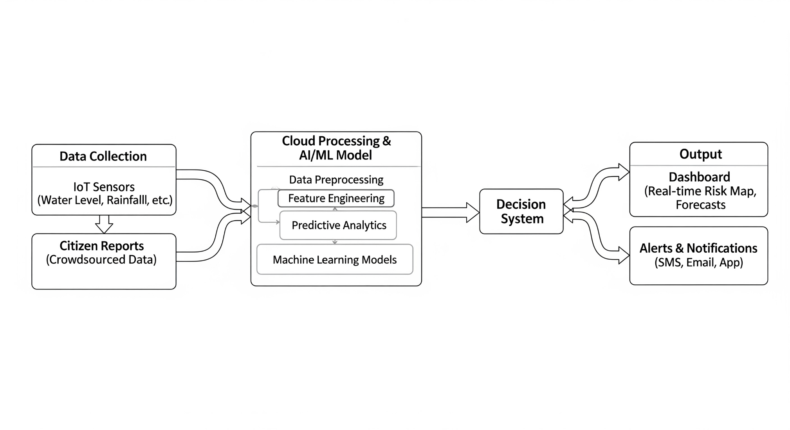
Use Case / UML Diagrams

Slide 8
Feasibility Study
Technical Feasibility → IoT sensors & Edge AI available, LSTM + MPC proven, SCADA integration possible
Economic Feasibility → Lower cost than infra expansion, reduced cloud/bandwidth cost, long-term savings
Operational Feasibility → Easy dashboard use, minimal staff training, autonomous functioning
Legal & Environmental Feasibility → Policy compliant, eco-friendly water management, flood damage reduction

Slide 9
Technology Stack
Hardware
IoT Sensors → Ultrasonic / Pressure / Rainfall sensors
Edge Devices → Raspberry Pi / NVIDIA Jetson Nano / Arduino
Software & Frameworks
Programming → Python, C++ (for embedded control)
AI/ML → TensorFlow / PyTorch (LSTM model)
Control → MPC libraries, NumPy, SciPy
Data Handling
Database → SQLite / MySQL for local storage
APIs → Weather API integration, SCADA compatibility
Cloud → AWS / Google Cloud for model retraining & backups
Visualization & Alerts
Dashboard → Flask / Django / Node.js + React
Alerts → SMS/Email (Twilio), Push Notifications
Security & Networking
Protocols → MQTT / HTTP for IoT communication
Security → TLS/SSL encryption, authentication layers

Slide 10
Expected Outcomes & Future Scope
Expected Outcomes (Pilot Phase)
Waterlogging Prevention → >30% reduction in overflow volume/frequency
System Efficiency → End-to-end decision latency <300ms
Prediction Quality → Flood prediction accuracy >95% TPR
Operational Reliability → ≥48 hours autonomous functioning without network
Cost & Maintenance → >50% reduction in emergency repair events
Future Scope
City-wide Deployment → Scale from pilot catchment to full urban network
Advanced Data Sources → Integrate satellite imagery, CCTV, and crowdsourced inputs
Predictive Maintenance → AI models for early detection of drain blockages
Integration with Smart City Systems → Link with traffic, disaster management, and IoT networks
Policy & Research Impact → Contribute to urban flood resilience planning and smart infrastructure design

Slide 11

Thank You
engg.dypvp.edu.in |

